Slide 1
9 Types of Mnemonics
For Better Memory

Slide 2
The bath and the bucket story (lateral thinking, making assumptions, dangers of judging people)
Given the title (on the subject of buckets..) and its quick simple message, this story is a good partner analogy to the rocks in a bucket time management story.
The story illustrates lateral thinking, narrow-mindedness, the risks of making assumptions, and judging people and situations:
A party of suppliers was being given a tour of a mental hospital.
One of the visitors had made some very insulting remarks about the patients.
After the tour the visitors were introduced to various members of staff in the canteen.
The rude visitor chatted to one of the security staff, Bill, a kindly and wise ex-policeman.
"Are they all raving loonies in here then?" said the rude man.
"Only the ones who fail the test," said Bill.
"What's the test?" said the man.
"Well, we show them a bath full of water, a bucket, a jug and an egg-cup, and we ask them what's the quickest way to empty the bath," said Bill.
"Oh I see, simple - the normal ones know it's the bucket, right?"
"No actually," said Bill, "The normal ones say pull out the plug. Should I check when there's a bed free for you?"

Slide 3
zodiac star signs story (for remembering the signs of the zodiac, and memory aid example for teaching mnemonics methods)
This story is a mnemonic (pronounced 'nemonic' - meaning memory aid) for remembering the twelve Signs of the Zodiac, in order, starting in January.
While this example is useful for pub quizzes, more importantly the method of creating a story mnemonic can be used to retain all sorts of difficult-to-remember pieces of information, for yourself, and taught to others. Mnemonics stories need not make sense - they simply need to be memorable.
In January, a goat (Capricorn), drinking from a stream (Aquarius) said, "Look, a fish (Pisces)."
A ram (Aries), and a bull (Taurus), carrying the twins (Gemini) said "There's also a crab (Cancer)."
A lion (Leo) roared in agreement, which startled the young maiden (Virgo) so that she dropped and smashed her scales (Libra).
"That's no crab - it's a scorpion (Scorpio)," said the archer (Sagittarius).
Note that the Signs of the Zodiac are normally deemed to start and end anything between the 18th and the 24th day of each month, depending on interpretation. It is not by any means a precise science.

Slide 4
https://www.youtube.com/watch?v=1eTtzH_4gP8
Memory

Slide 5
Dog six nut in clam pencil did
Tent on carrot donut oak pretty
Bug walnut bush shirt brown two
Wolf piano hip celery chop help
Jump fit time truck cello swim
Fig banana flip nine telephone dirt
Pug car pond sing yam trailer
House clock big sleeve torn hug

Slide 6
Clustering is used to organize related information into groups. Information that is categorized becomes easier to remember and recall. For example, consider the following group of words:
Desk, apple, bookshelf, red, plum, table, green, pineapple, purple, chair, peach, yellow
Spend a few seconds reading them, then look away and try to recall and list these words. How did you group the words when you listed them? Most people will list using three different categories: color, furniture and fruit.

Slide 7
Clustering is used to organize related information into groups. Information that is categorized becomes easier to remember and recall. For example, consider the following group of words:
Desk, apple, bookshelf, red, plum, table, green, pineapple, purple, chair, peach, yellow
Spend a few seconds reading them, then look away and try to recall and list these words. How did you group the words when you listed them? Most people will list using three different categories: color, furniture and fruit.

Slide 8
Read the following list of words:
grapes table bus apple chair airplane
desk banana sofa car train plum
lamp motorcyle strawberry dresser bicycle peach
Chances are that you automatically grouped these items into three clusters:
fruits, furniture and modes of transportation
Clustering involves organizing information in memory into related groups. Memory is clustered into groupings during recall from long-term memory.

Slide 9
Read the following list of words:
grapes table bus apple chair airplane
desk banana sofa car train plum
lamp motorcycle strawberry dresser bicycle peach
Chances are that you automatically grouped these items into three clusters:
fruits, furniture and modes of transportation
Clustering involves organizing information in memory into related groups. Memory is clustered into groupings during recall from long-term memory.

Slide 10
Dog house nut six
wolf tent carrot car nine
pug trailer celery truck sing
Hug chop swim
bug donut jump
yam flip
in on clam pencil did
banana
oak pretty brown shirt torn sleeve
Notes:
Put the words in categories.

Slide 11
Mnemonics are memory devices that help learners recall larger pieces of information, especially in the form of lists like characteristics, steps, stages, parts, etc.
In 1967 a study by Gerald R. Miller that mnemonics increased recall.
He found that students who regularly used mnemonic devices increased test scores up to 77%!

Slide 12
Many types of mnemonics exist and which type works best is limited only by the imagination of each individual learner.
9 basic types of mnemonics include
Music, Name, Expression/Word, Model,
Ode/Rhyme, Note Organization,
Image, Connection, and Spelling Mnemonics.

Slide 13
1. Music Mnemonics
How many lyrics to songs do you remember? How did you come to remember them?
Music is a powerful memory technique and it can work just as well in college, also.
Many students have made songs out of information when a list of items must be learned.
Advertising on radio and TV uses this technique to help potential customers remember their products when shopping.

Slide 14
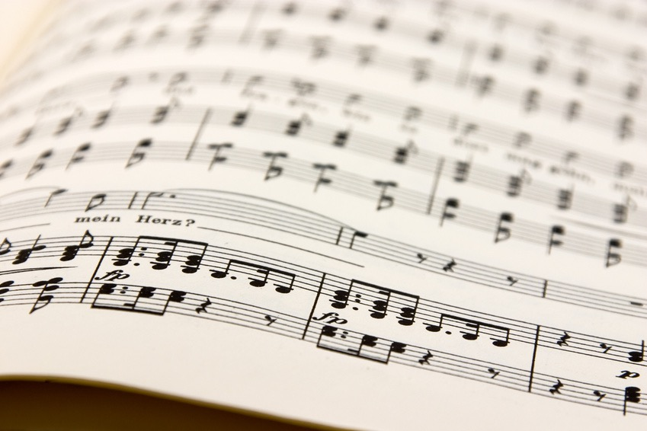
http://www.princetonreview.com/vocab-minute.aspx
http://www.npr.org/templates/story/story.php?storyId=6732411
http://www.npr.org/player/v2/mediaPlayer.html?action=1&t=1&islist=false&id=6732411&m=6732494
http://www.npr.org/player/v2/mediaPlayer.html?action=1&t=1&islist=false&id=6732411&m=6732494
Spit ball in the sky
http://blogs.longwood.edu/lamusica/2013/05/01/mnemonics-using-music-to-memorize/ Bone Dance

Slide 15
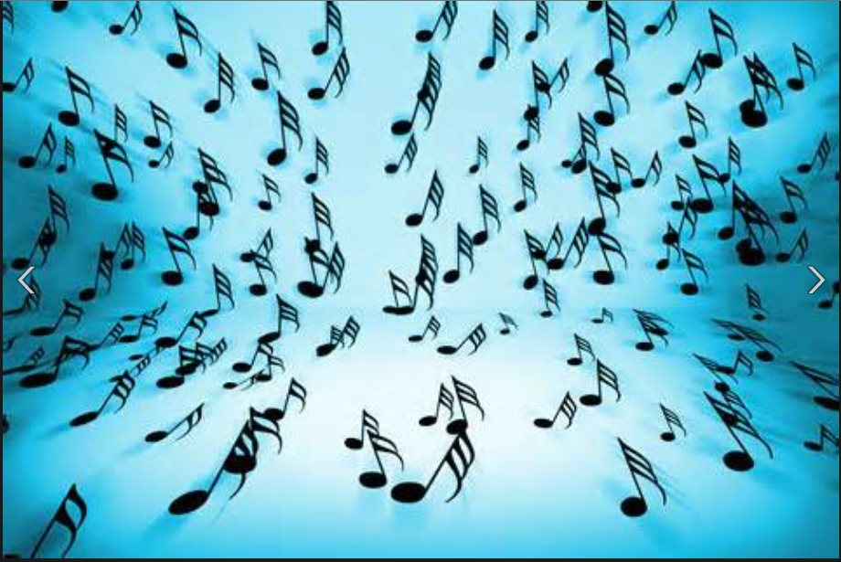
http://blogs.longwood.edu/lamusica/2013/05/01/mnemonics-using-music-to-memorize
Spit ball in the sky
http://www.npr.org/player/v2/mediaPlayer.html?action=1&t=1&islist=false&id=6732411&m=6732494

Slide 16
http://www.princetonreview.com/vocab-minute.aspx
Assignment:
With a partner or team create a short song using the following vocabulary words:
Obliterate uh blit uh rate to wipe out
Debilitate d i(ck) bil i(ck) tate to weaken
Taciturn tas i(ck ) turn reluctant to talk
Officious (uh fish us) interfering
Spurn to reject
Use a simple song like Row, Row, Row, Your Boat, Mary had a little Lamb, I’ve been
Working on the Railroad, or Wheels on the Bus, Jingles Bells , Christmas Tree

Slide 17
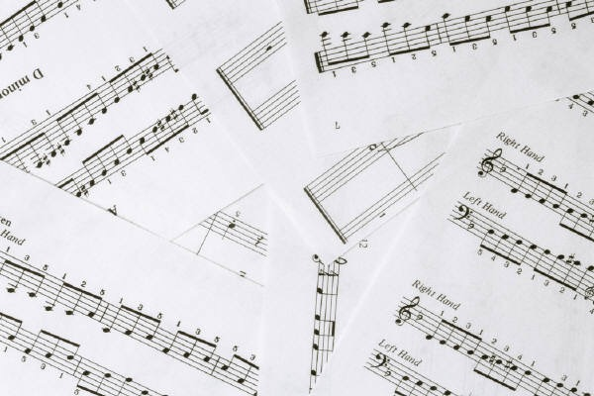
http://www.wikihow.com/Memorize-Words-Fast-and-Effectively steps

Slide 18
http://gazette.teachers.net/gazette/wordpress/susan-fitzell/remember-vocabulary-2/
http://www.wikihow.com/Memorize-Words-Fast-and-Effectively

Slide 19
2. Name Mnemonics
In a Name Mnemonic, the 1st letter of each word in a list of items is used to make a name of a person or thing. An example is:
ROY G. BIV = colors of the spectrum (Red, Orange, Yellow, Green, Blue, Indigo, Violet.)

Slide 20
Using the same vocabulary words, create a name mnemonics.
Obliterate uh blit uh rate to wipe out
Debilitate d i(ck) bil i(ck) tate to weaken
Taciturn tas i(ck ) turn reluctant to talk
Officious (uh fish us) interfering
Spurn to reject

Slide 21
3. Expression or Word Mnemonics
This is by far the most popularly used mnemonic. To make an Expression or Word mnemonic, the first letter of each item in a list is arranged to form a phrase or word. Examples include:
For physical laws dealing with gasses, try these:
Charles’ Law: For a constant volume, pressure is directly proportional to temperature.
The simple way to remember Chuck is if the tank’s too hot, you are out of luck.
Henry’s Law: The solubility of a gas increases with pressure.
The way to remember good old Hank is think of bubbles in the Coke you drank.
Boyles’ Law: At constant temperature, pressure is inversely proportional to volume.
Boyle’s law is best of all because it presses gasses awfully small.

Slide 22
In English, the 7 coordinating conjunctions are For, And, Nor, But, Or, Yet, So = FANBOYS.
Burp!
The order of operations for math is Parentheses, Exponents, Multiply, Divide, Add, and Subtract = PLEASE EXCUSE MY DEAR AUNT SALLY.
The categories in the classification of life are Kingdom, Phylum, Class, Order, Family, Genus, Species, Variety = KINGS PLAY CARDS ON FAIRLY GOOD SOFT VELVET.
For those who have to remember the order of color coding on electronic resistors: BLACK, BLUE, RED, ORANGE, YELLOW, GREEN, BROWN, VIOLET, GRAY, WHITE, SILVER, GOLD.
Bad Boys Rile Our Young Girls, But Violet Gives Welts (to) Silly Guys
or
Bad Beer Rots Our Young Guts But Vodka Goes Well (in) Silver Goblets.
Almost every anatomy class has to remember the eight small bones in the wrist: NAVICULAR, LUNATE, TRIQUETRUM, PISIFORM, MULTONGULAR (GREATER), MULTONGULAR (LESSER), CAPITATE (and) HAMATE.
Never Lower Tilly's Pants, Mother Might Come Home.

Slide 23
Create an Expression Mnemonic for remembering the order of the planets from the sun outward: Mercury, Venus, Earth, Mars, Jupiter, Saturn, Uranus, Neptune, and Pluto.

Slide 24
4. Model Mnemonics
In Model Mnemonic, some type of representation is constructed to help with understanding and recalling important information.
ORGANIZATION CHART OR IDEA TREE
MIND MAP
3 Ways to remember
Repetition
Association
Mnemonics
Regular
Frequent

Slide 25
5. Ode or Rhyme Mnemonics
An Ode or Rhyme Mnemonic puts information to be recalled in the form of a poem.
Recall
Examples include:
1. A commonly used Rhyme Mnemonic for the number of days in each month is:
30 days hath September, April, June, and November. All the rest have 31, Fine! February 28 except when 29.
You’d probably like your doctor to know the difference between cyanate and cyanide: Cyanate “I ate” and Cyanide “I died.” Cyanide is a deadly poison.
In 1492, Columbus sailed the ocean blue.
4. I before e except after c
or when sounding like a
in neighbor and weigh
Here is an easy way to remember the nerves: olfactory, optic, oculomotor, trochlear, trigeminal, abducens, facial, acoustic, glassopharyngeal, vagus, spinal accessory and hypoglossal.
On Old Olympus’ Towering Tops, A Finn And German Viewed Some Hops

Slide 26
6. Note Organization Mnemonics
The way textbook and lecture notes are organized can inhibit learning and recall or promote it.
In the sense that the organization of notes can promote recall, it is a memory device.
Three examples of organizing note formats that promote recall are as follows:
1. Notecards
Notecards are an easy way to organize main ideas and relevant details to be recalled. If main ideas are formatted into possible test questions, notecards can give learners practice in seeing questions and recalling answers as they must do on exams.
1 . Concentration score sheet - put a checkmark on the sheet every time I lose concentration.
2. Jot worrisome thoughts on paper and do something about them after studying.
According to Pauk, what are 2 ways to discourage internal distractions?

Slide 27
2. Outlines
Outlines clearly separate main ideas from details. This helps organize the information in the mind making it easier to remember.
I. PIAGET'S THEORY
A. Four Stages
1. Sensorimotor
2. Preoperational
3. Concrete Operations
4. Formal Operations
B. Definition of each stage
1. Sensorimotor means ....

Slide 28
3. Cornell System
The Cornell System is another way to use a Note Organization Mnemonic to promote recall. A vertical line is drawn 3 inches from the left margin of notebook paper. Main ideas or questions from them are placed to the left of the line and details or answers placed to the right. A summary is about 2 inches from the bottom of the page.
Questions
Answers
A system for mastering new vocab.
1.Look for somewhat familiar words.
2. Learn these meanings
1. Frontier words=are easiest to learn2. Foundation for lrng other frontier words
Prodigal ‑ Has something to do with a son who left home and was living an extravagant, carefree life.
text p.292
What is the Frontier Vocab Sys.?.
text p.293‑294
How does the FVS Sys. Work?
lecture 10/30
Why use the FVS?
Example of one of my
Studying in college is different from studying in high school. The Frontier vocabulary System is easy to learn. It is a great system for mastering new vocabulary.

Slide 29
7. Image Mnemonics
The information in an Image Mnemonic is constructed in the form of a picture that promotes recall of information when you need it.
The sillier the Image Mnemonic is, the easier it is to recall the related information.
These images may be mental or sketched into text and lecture notes.
Don’t worry about your artistic ability. As long as you know what your sketch means, Image Mnemonics will help you learn and remember.
Examples include:
You can use an Image Mnemonic to remember BAT (the depressant drugs mentioned above - Barbiturates, Alcohol, and Tranquilizers). Visualize or sketch in your notes a limp, depressed bat that took Barbiturates, Alcohol, and Tranquilizers.
Picture meeting someone new at a party named John Horsley. Use an Image Mnemonic to help you remember his name. Visualize a horse sitting on a john: not pretty but effective in recall.
What is a numismatist ? Visualize an image of a new mist rolling onto a beach from the ocean and beach is made of coins. Silly? Of course, but sillyography makes it is easier to remember that a numismatist is a coin collector.
How about using a bad joke to help you remember? Picture an image of two numismatists having a drink for “old dime’s sake.” Corny? Yes, but cornography often makes things easier to remember.

Slide 30
8. Connection Mnemonics
In this type of mnemonic, the information to be remembered is connected to something already known.
Examples include:
Remembering the direction of longitude and latitude is easier to do when you realize that lines on a globe that run North and South are long and that coincides with LONGitude.
Another Connection Mnemonic points out that there is an N in LONGitude and an N in North. Latitude lines must run east to west, then. There is no N in latitude.
Another Connection Mnemonic is related to sound. The 1st part of the word latitude sounds like flat and flat runs horizontal or East and West.

Slide 31
9. Spelling Mnemonics
1. Here is an example of a spelling mnemonic: A principal at a school is your pal, and a principle you believe or follow is a rule.
2. Another commonly used Spelling Mnemonic is combined with an Ode/Rhyme Mnemonic.
I before e except after c
or when sounding like a
in neighbor and weigh
To spell Mississippi, many learners combine a Rhythm Mmnemonic with a Spelling mnemonic: M-iss-iss-ipp-i.
Here are some more examples of spelling mnemonics:
Geography: George Edwards Old Grandma Rode A Pig Home Yesterday.
Arithmetic: A Rat In The House May Eat The Ice Cream.

Slide 32
 | Student Academic Resource Center

Slide 33
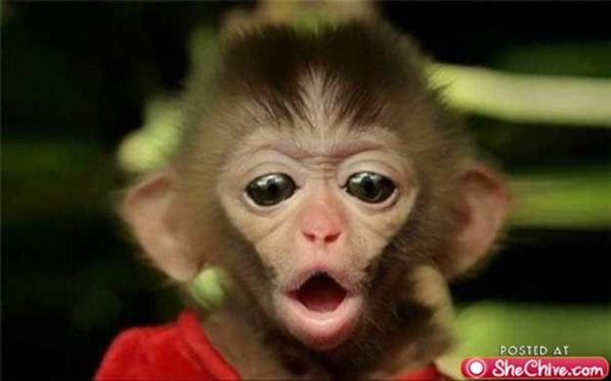
That’s All!

